Slide 1
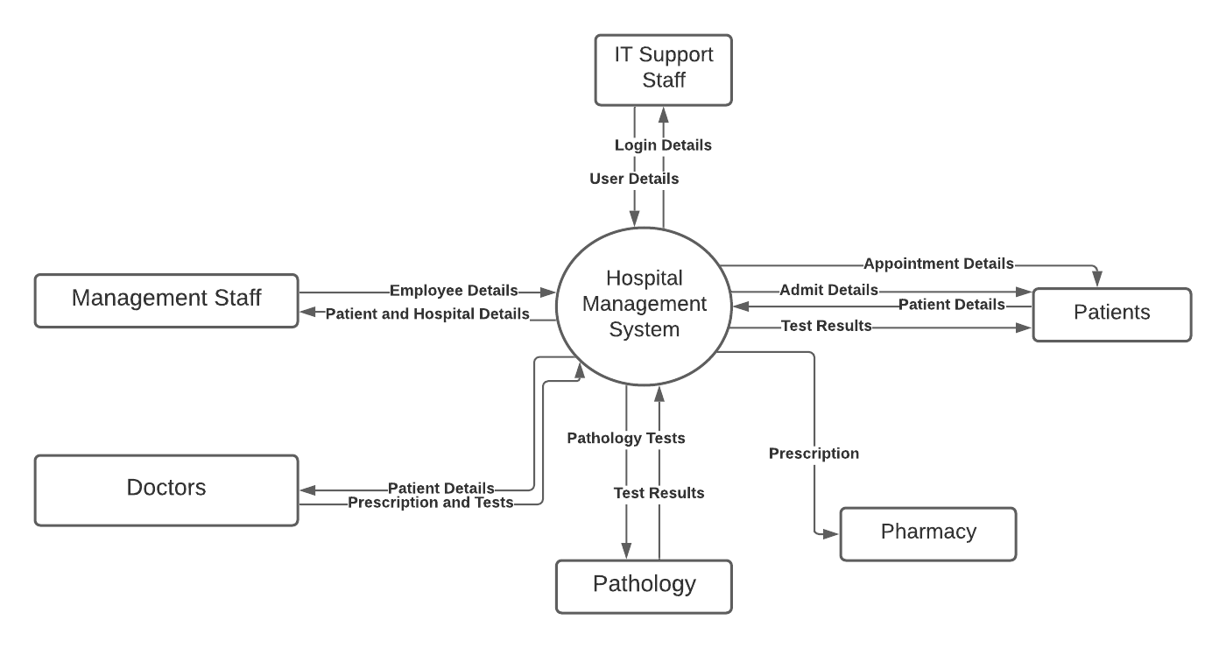
Level 0:

Slide 2
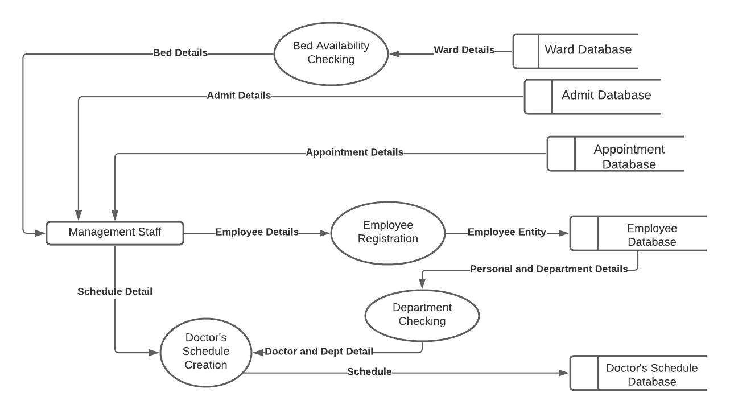
Level 1 for Management Staff:

Slide 3
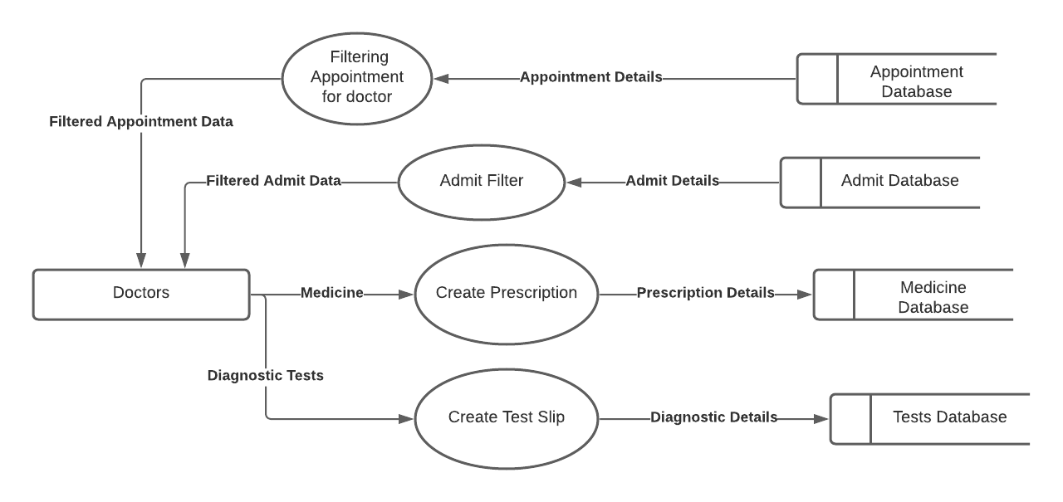
Level 1 for Doctor:

Slide 4
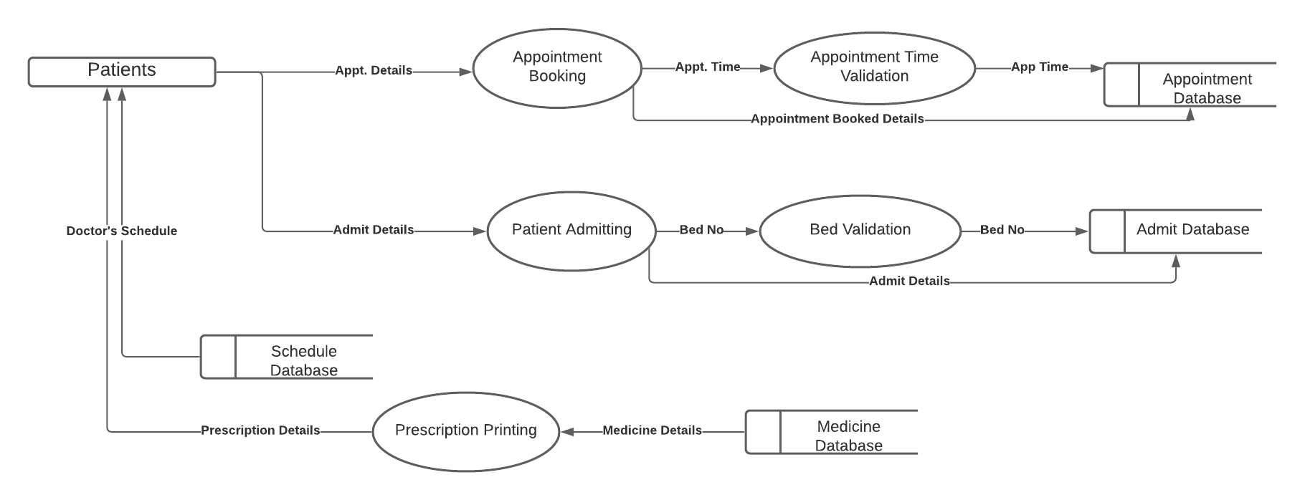
Level 1 for Patients:

